Slide 1
Part II
Notes:
Facilitator:
The purpose of Part II is to go more deeply into the philosophies and values of our district. We examine how to apply the philosophy, generally using local resources and interviews of past and present leaders.

Slide 2
Hiring is the most important thing we do…
“The ‘failing’ comparison companies frequently followed the ‘genius with a thousand helpers’ model. The ‘genius’ leader set the vision and then enlists highly capable “helpers” to make the vision happen. This model fails when the genius departs.” Jim Collins
“An educational program can only be as good as it’s staff. So, you start with the one’s who will do it…just as there are master craftsmen, there have to be master teachers. My job is to search them out and give them support.”
Floyd B. Buchanan, Ed.D.
Notes:
Script: Tiers I, II, III
Facilitator:
For us to demonstrate our belief around “lifelong learning” it is important to explore resources that can challenge and expand our thinking. It is also important that we examine our own philosophies and values. At CHARGE, one year, we all read Good to Great by Jim Collins. We learned about things like hedgehogs and flywheels. Jim Collins studies companies from around the world and identifies the characteristics that make them an outstanding company. Much of what he has found can be applied to school systems. We are going to examine key concepts from chapter 3 of his book Good to Great in Part III of this module. In the meantime, compare these two quotes from Collins and our own Dr. Buchanan.
Discussion Points:
Turn to a neighbor and compare the two statements on the screen. How are they the same and how are they different? Identify one lesson that can be learned from each statement.
Ask each pair to share one way they are the same, one difference, and one lesson to be learned.

Slide 3
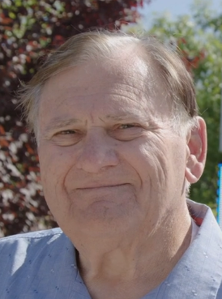
“If you want to develop winners, surround our children with winners.” Doc Buchanan
“I was really concerned about quantified, successful, leadership experiences. I didn't care what it was. It could be Tiddly Winks, or the band, or anything. What have you done that demonstrates to me that you're a successful person. I think that was very important. And I think that's the mantra that Doc established and the culture he created… that continues today.”
Jim Fugman, Ed.D.
Notes:
Script: Tiers I, II, III
Facilitator:
CUSD schools are often named after successful leaders. Dr. Fugman was definitely a successful leader. He came to Clovis from Fresno Unified and began his career in Clovis as the football coach for Clovis High School. He helped put Clovis High on the map as far as being a school to be reckoned with in both academics and cocurricular programs. He later did the same for Kastner Intermediate School, leading it to become both a California Distinguished School and a National Blue Ribbon. Jim ended his career in Clovis Unified as Deputy Superintendent of Curriculum and Instruction.
Ask participants to turn to a neighbor and discuss why the concept of surrounding children with winners is important.
Discussion Points:
In a group of four ask participants to answer/discuss one or more of the following:
101 – What makes a person a “winner”? Notice Jim talks about quantified successful leadership. What measurements can we use to quantify success.
201 – Think about your “winning” attributes? How do they contribute positively to student success?
301 – Think about someone at your school site/department you consider a “winner”. What are the attributes of that person? Think about someone who has limited attributes of a “winner.” Is there anything you can do as a site leader to help that employee become a winner?
As a group choose one person to share your answer with all participants.
Share responses.

Slide 4
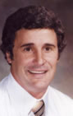
We look for people a cut above average
“What have you heard about Clovis Unified?”
That was a favorite interview question of Rene Errotabere. In response, he would often hear comments about
how much was expected of employees and students,
how high standards were set,
and about the push for excellence that was ingrained in the organization.
“Hmm…” he’d reply, “Well, that’s all true! Do you still want to work here?”
Notes:
Script: Tier I, II, III
Facilitator:
Rene Errotabere was another successful leader. One of the gyms at Buchanan High school is named after Rene (insert personal story if you have one). Rene passed away in his 50s after battling brain cancer. Today, CUSD awards a scholarship to a student from each high school who epitomizes the characteristics displayed by Rene. Rene completed his career in CUSD as the Assistant Superintendent of the Buchanan Area.
Discussion Points:
Rene was certainly a “cut above” average when he was hired in CUSD. In groups of three discuss one or more of the following:
101 – Look at the three bullet points on the slide. Have you heard this about CUSD? What other perceptions, both positive and negative, have you heard from students, parents, and community members?
201 –Why would Rene spend so much time on such a simple question like “What have you heard about Clovis Unified?” before inviting them to join the district. Why is this important to the continuing success of Clovis Unified?
301 – What are the perceptions you want people to have about your school site/department? What do you believe to be the current perceptions? What data do you use to measure perceptions?
As each group finishes ask for volunteers to share their responses.

Slide 5
We hire role models reflective of our student community.
“When hiring teachers and administrators, CUSD has sought to find individuals of varied personalities, ones who are not “yes” men saying only what they think people want to hear; rather, teachers and administrators hired in CUSD are people competent in their fields, from a variety of backgrounds, who are able to relate to the broad spectrum of students and parents who compose the school district.”
Historical Overview of Clovis Unified, p. 18
Notes:
Script: Tiers I, II, III
Facilitator:
In the late 1980s, just prior to the end of his tenure in Clovis Unified, Doc recorded a historical overview of the development of our district that captures many of the rationales for the philosophies and values on which our organizational culture was built. Please read the excerpt from the section “Role of a Leader” from page 18 of the Historical Overview of Clovis Unified. Notice, one of our foundational values has always been to hire role models reflective of our student community.
Discussion Points:
In a triad come to a consensus on the answer for one or more of the following questions (facilitators choice). Provide examples to support your answers.
101 - Why is it important to hire individuals from a variety of backgrounds?
201 - Why is it important to not hire “yes” men and women?
301 – Describe the characteristics you, as a leader, want an employee to possess. Rate them on a scale from 1-10 with 1 being the most important characteristic.
Ask each triad share their response.

Slide 6
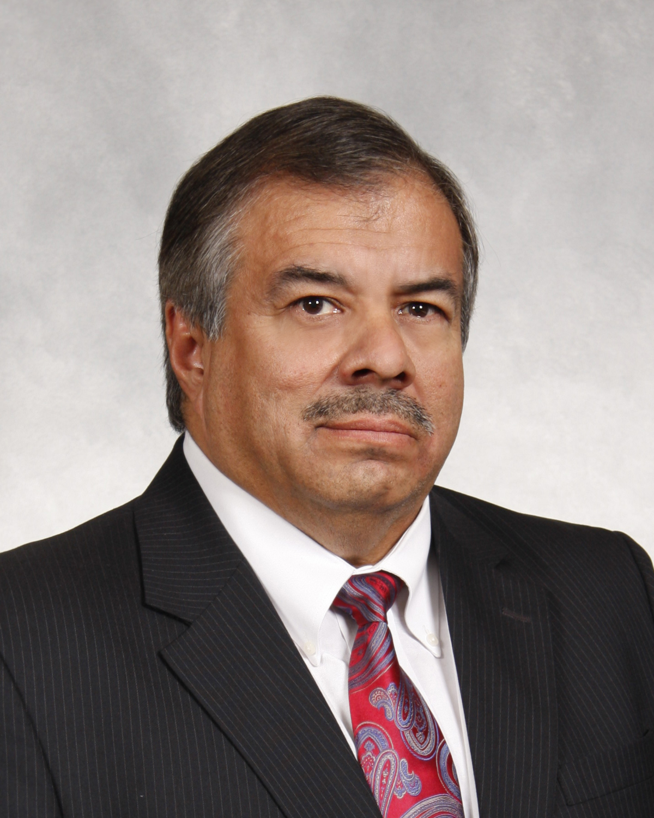
We hire role models reflective of our student community.
“What we were faced with many times, was that candidates of diversity didn't want to necessarily come to Clovis because they had a stereotype in their mind about what Clovis was. So, we didn't wait for them to come to us. We went to them. What I mean by that is that at a job fairs, we would send leaders of diversity and they would start to break down some of those barriers and make connections. That kind of put the whole idea of recruiting on its head. When a candidate said “Hey, I thought there weren’t any Hispanics in Clovis,” it gave us the opportunity to demonstrate that Clovis did have diverse leaders and that they enjoyed working in CUSD.”
Joe Hernandez, EdD.
Notes:
Script:
Facilitator:
Dr. Joe Hernandez is currently the Superintendent of Dinuba Unified School District. He worked in Clovis Unified for ten years, serving as the Administrator of Human Resources and ending his career in CUSD as the Assistant Superintendent of the Buchanan Area. Dr. Hernandez does an excellent job in explaining one of the challenges Clovis Unified faces when hiring role models reflective of our community and the steps we take to overcome those challenges. Ask participants to read the quote on the screen. Once they are done move into small groups for the next activity.
Discussion Points:
In a small group, record five stereotypes you have heard about Clovis Unified, positive or negative. Think about what might contribute to that perception. Each group shares their responses. After responses are shared discuss one or more of the following (facilitator’s choice).
101 – Is it important to have a variety of individuals involved in the hiring process? Explain who should be involved in the hiring process and why.
201 – Of all the stereotypes recorded which do you find most bothersome? Why?
301 – Of all the stereotypes listed, which do you feel negatively impacts the District’s reputation the most? How should the district address this stereotype?
Each group will share their response to the question chosen.

Slide 7
A Clovis Unified leader hires the people who meet the needs of the school site/department, then is held accountable for that hire.
Think about your role in the hiring process, your role as a leader, and accepting accountability for your hires. In a small group discuss the questions below:
How do you support employees who can do the job for which they were hired?
How do you support those employees who can’t do the job for which they were hired?
How do you support employees who won’t do the job for which they were hired?
Historical Overview of CUSD, p.19
Notes:
Script: Tier I, II, III
Facilitator:
As leaders in CUSD we play a huge role in the hiring and evaluation of our employees. Pages 19-21 of the Historical Overview of CUSD (available in resource folder) explains a leader's role in the hiring process. Please form small groups to read the Role of a Leader. Allow time for participants to read the excerpt.
Discussion Points:
Doc describes three categories of staff:
Those who can do the job
Those who can’t do the job,
And those who won’t do the job.
In your group discuss the questions on the screen.
101 – What type of support do you provide to employees who can do the job for which they were hired? Use examples to explain your answers.
201 – How do you support an employee who cannot do the job for which they were hired? Use examples to explain your answers.
301 – How do you support employees who won’t do the job for which they were hired? Use examples to explain your answers.
Additional Questions (facilitator’s choice).
Do you consider evaluations to be a form of support for an individual. Explain your answer.
How do your answers change, or do they when you are the leader, but you were not the person who hired the individual?
Ask groups to share their responses without repeating what has already been shared.

Slide 8
Hiring is the most important thing we do…
“As long as the leaders of Clovis Unified continue to remember that the organization is more important than any one individual, and that the culture, traditions and core values of CUSD are stronger than that of any one leader, Clovis Unified will continue to be a ‘destination’ district for ALL students.”
Terry Bradley, Ed.D.
This Photo by Unknown Author is licensed under CC BY-SA
Notes:
Script: Tiers I, II, III
Facilitator:
Dr. Terry Bradley was a thirty-four-year employee of Clovis Unified. He worked as an Administrator, Assistant Superintendent, Deputy Superintendent of Administrative Services, and as Superintendent from 2002-2007. He also served as Interim Superintendent in transition periods between Dave Sawyer and Kent Bishop. Terry felt strongly about the legacy of the CUSD organization. Read the quote on the screen. Facilitator may read, popcorn read, or ask a participant to read the values on the screen.
Discussion Points:
In a triad discuss one or more of the following, coming to a consensus for your answer:
101 - What is the meaning behind Dr. Bradley’s quote? How does it relate to the philosophy hiring is the most important thing we do?
201 – Dr. Bradley called Clovis Unified a “destination” district for ALL students. Why is the word ALL capitalized? Do you agree with this statement? Explain why or why not?
301 – Look closely at the wordle on the screen. Of the words, that you can see, explain what it means in CUSD. For instance:
Loyalty - who are you loyal to?
Customer – who is our customer
Quality – how do you know when something is of quality
As triads complete their conversations, ask them to share their group responses. Allow for discussion, if time permits.

Slide 9
End of Part II
Notes:
Facilitator:
Depending on your time allocation and the audience you have several options.
The PowerPoint is designed for you to use the slides you choose in any order.

